Slide 1
CovidCare
Presented by:
Amir Khaidir bin Adzeman 192212
Anis Nur Hajar binti Ahmad Rizal 192560
Nur Aida Farahanie binti Ahmad 192494

Slide 2
01.Introduction
02. Main features
What is CovidCare
What is the main functionality of CovidCare
03. tools
What tools that were being used to develop CovidCare
04. demo
05. conclusion
Demo on how CovidCare works
Summarization of this CovidCare

Slide 3
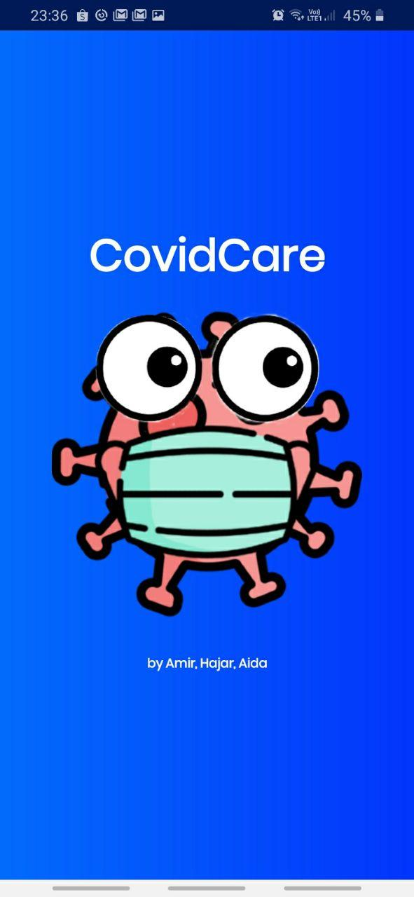
introduction
01

Slide 4
What is CovidCare?
A mobile-based application
Improvisation the user interface of MySejahtera Application
Notes:
It is in the health category
It is build by improving the ui of mysejahtera

Slide 5
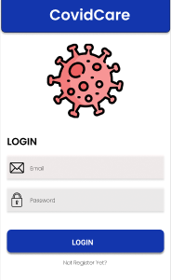
Main features
02

Slide 6
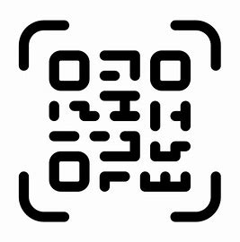
Main features
Digital Health Care
Additional Resources (SOP, Hotline Number
QR Scanner
Extra Information on the Covid-19 symptoms & prevention
Notes:
As for the main features, we do provide these 4 main features in CovidCare which are: The first one is we connect the user to the several digital health care in this CovidCare such as bookdoc website, doctoroncall, doc2us and others. Next, we do provide the additional resources such as the SOP, covid19 hotline number and so on.
Then, we do provide the qr scanner to ease the user in scanning the qr code.
We also provide the extra information on the covid 19 symptoms and prevention by connecting it to the youtube video.

Slide 7
Tools used
03

Slide 8


Tools for the development
figma
Android studio

Slide 9
demo
04
Here we presented to you our:

Slide 10
conclusion
05

Slide 11
Conclusion
01
02
To implement what we have learn in class and lab into this CovidCare project.
To develop a working system related to Covid-19 pandemic using Android Studio
03
04
Improvise the UI of MySejahtera Apps

Slide 12
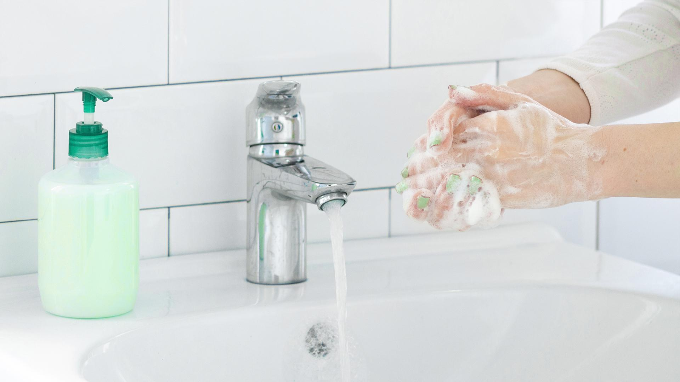
WE MUST each DO OUR part

Slide 13
Thank you

